Slide 1
LookingBus end-to-end testing
Final Mobile Application Testing Project. Team 6.

Slide 2







QA Team
Andrew Zyuzikov
Samsung A30 Android 11
Kat Vlasova
emulator Nexus 4 API 31 Android 12
Yulia Zelenova
emulators Pixel 2 API 30 Nexus 6P API 31 Android 11
Tatiana Kaplenko
emulator Nexus 6P API 29 Android 10
Sam Bennett
iPhone Xr iOS 14.7
Mikhail Slavin
iPhone 13 Max Pro iOS 16
Marina Vorobyeva
iPhone 11 iOS 14.8

Slide 3
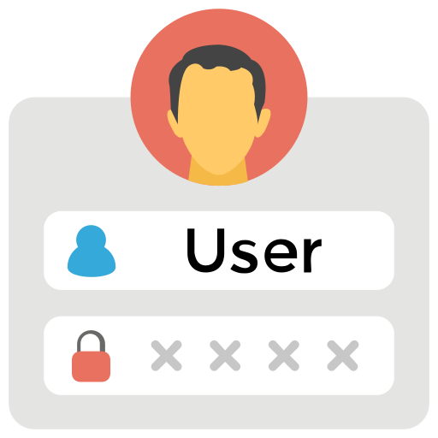

What is E2E testing
End-to-end testing (E2E) approach starts from the end user’s perspective and simulates a real-world scenario
The entire application is tested for communicating with other systems, interfaces, database, network, and other applications

Slide 4
Basic example of E2E test
Log in
Reserve a bus
Make the bus trip
Log out

Slide 5
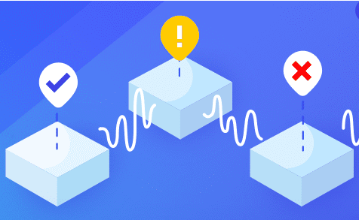
Purpose of E2E testing
To ensure that applications behave as expected and that the flow of data is maintained for all kinds of user tasks and processes
To determine if various dependencies of an application are working correctly
To verify if accurate information is being communicated between multiple system components

Slide 6
Why E2E testing important
Better test coverage (more detailed test cases)
Test cases based on the end user’s behavior
Improves users’ experience
Reduce time-to-market by automating critical paths (core functions)
Less testing time less overall cost
Reveal more bugs

Slide 7
Challenges in E2E testing
It takes a complete understanding of the product
Must be designed to reproduce real-world scenarios
Requires a good understanding of end-user goals
Lack of end-user environments (devices)

Slide 8
E2E testing process
Requirements
Environment
Design
Test Cases
Execution
Requirements capturing,
another documentation studying
Test environment setup: software/hardware, emulators and devices preparing
Description of all app components, user workflows,
designing test cases ideas
Developing test cases, input data,
traceability matrix
Test cases execution in test environment, status reposting,
bugs tracking

Slide 9
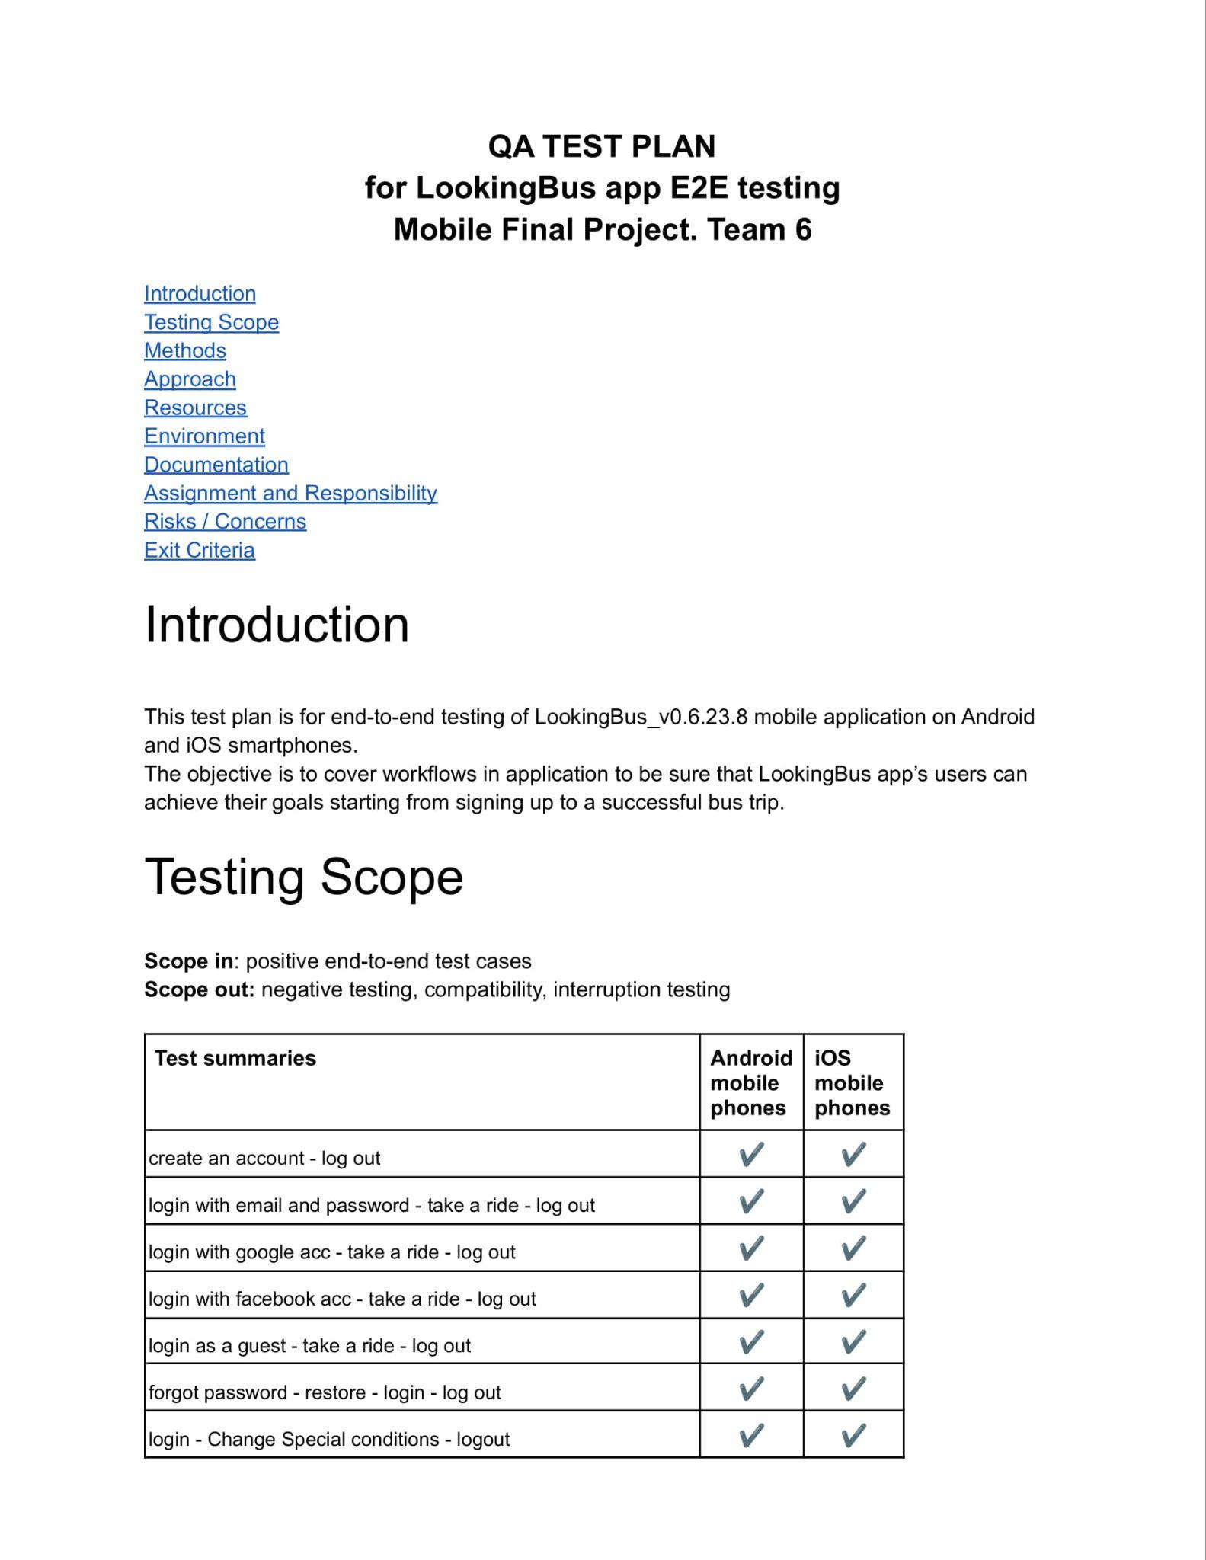
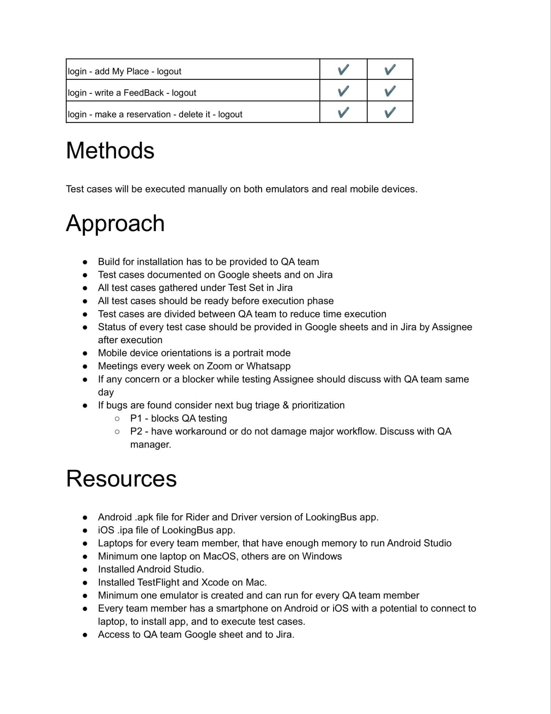
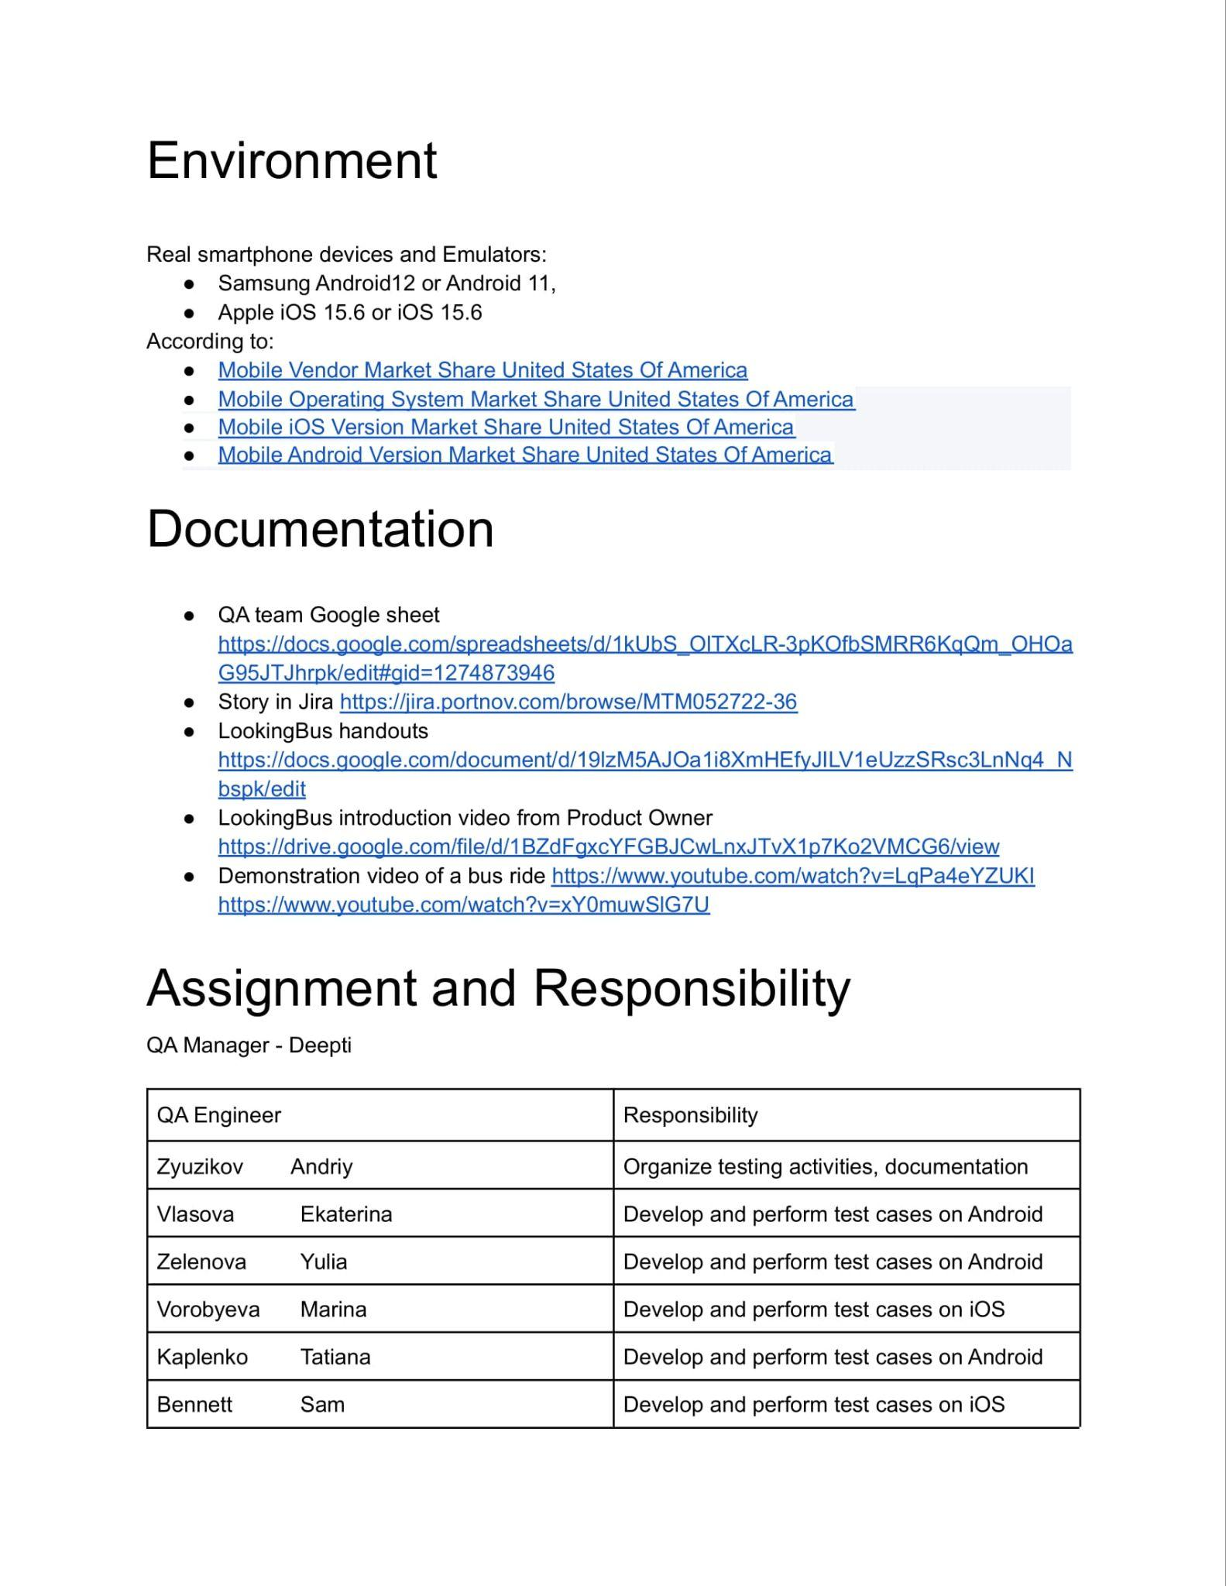
Test plan
Link to Google Doc: https://docs.google.com/document/d/131Hey1ZvCoWHNaABA1O9qLQb73vEvKuEEtnKuimW1FU/edit#

Slide 10
Testing environment research

Slide 11

Smartphone use by people
with disabilities
84% use smartphone daily
70% use apps
Source: https://www.inclusivecitymaker.com/infographic-smartphone-use-disabled-people/

Slide 12
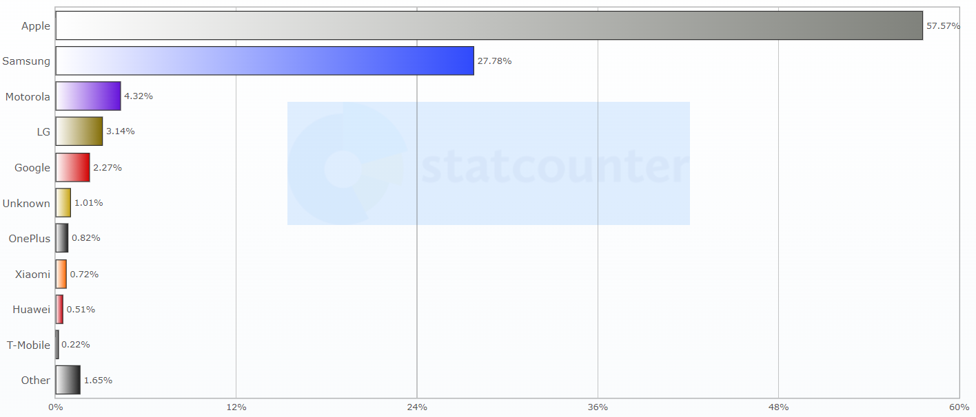
US Mobile Vendors

Slide 13
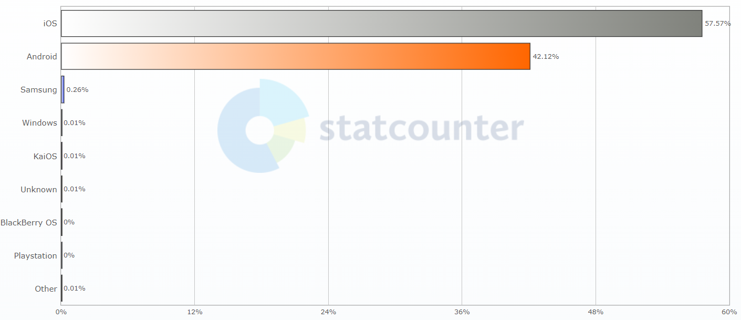
Mobile Operating Systems in US
84% use smartphone daily
70% use apps

Slide 14
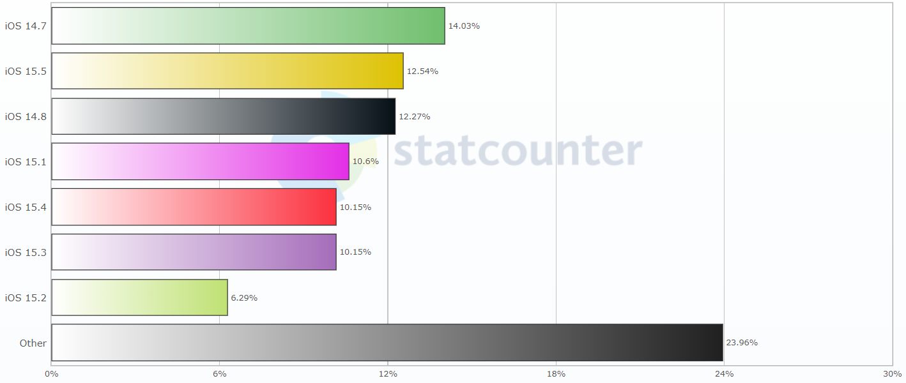
Mobile iOS Versions in US
84% use smartphone daily
70% use apps

Slide 15
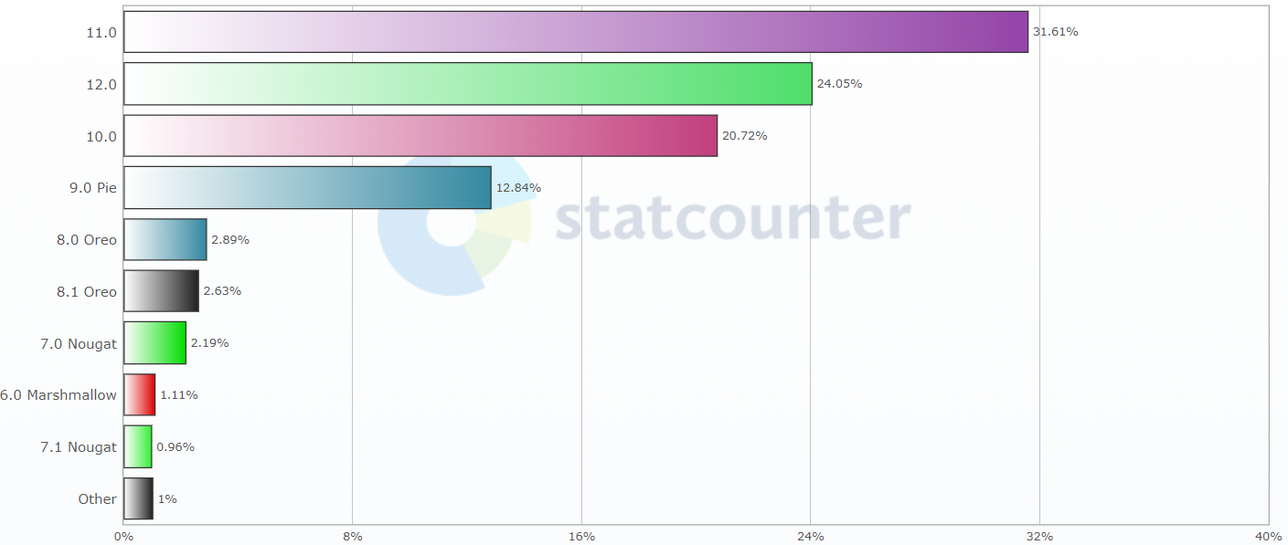
Android Versions in US
84% use smartphone daily
70% use apps

Slide 16
Test design

Slide 17
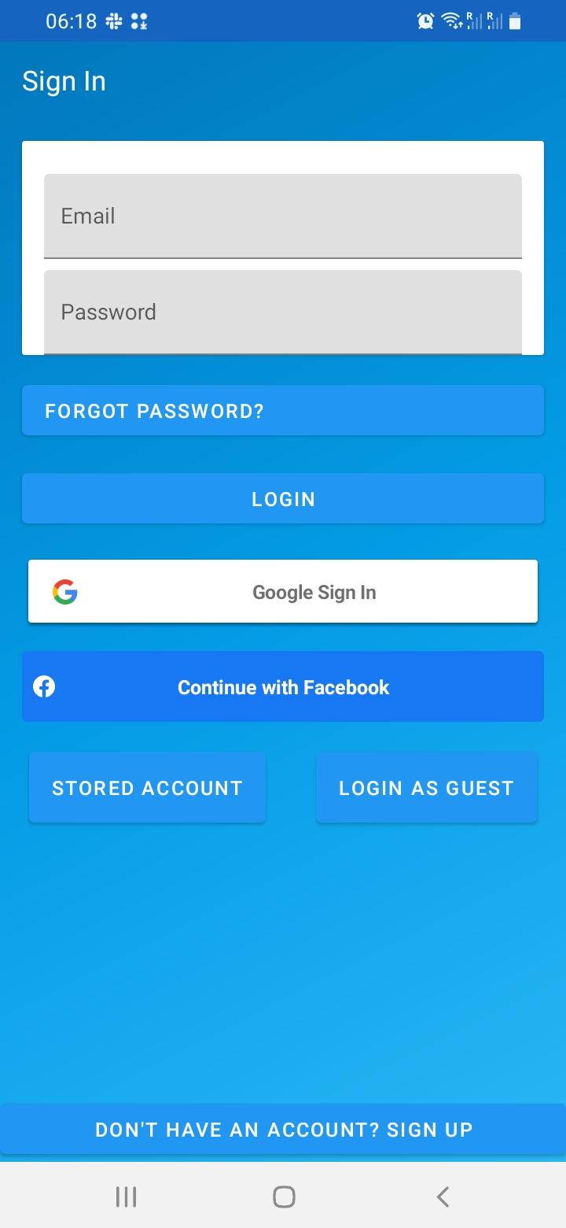
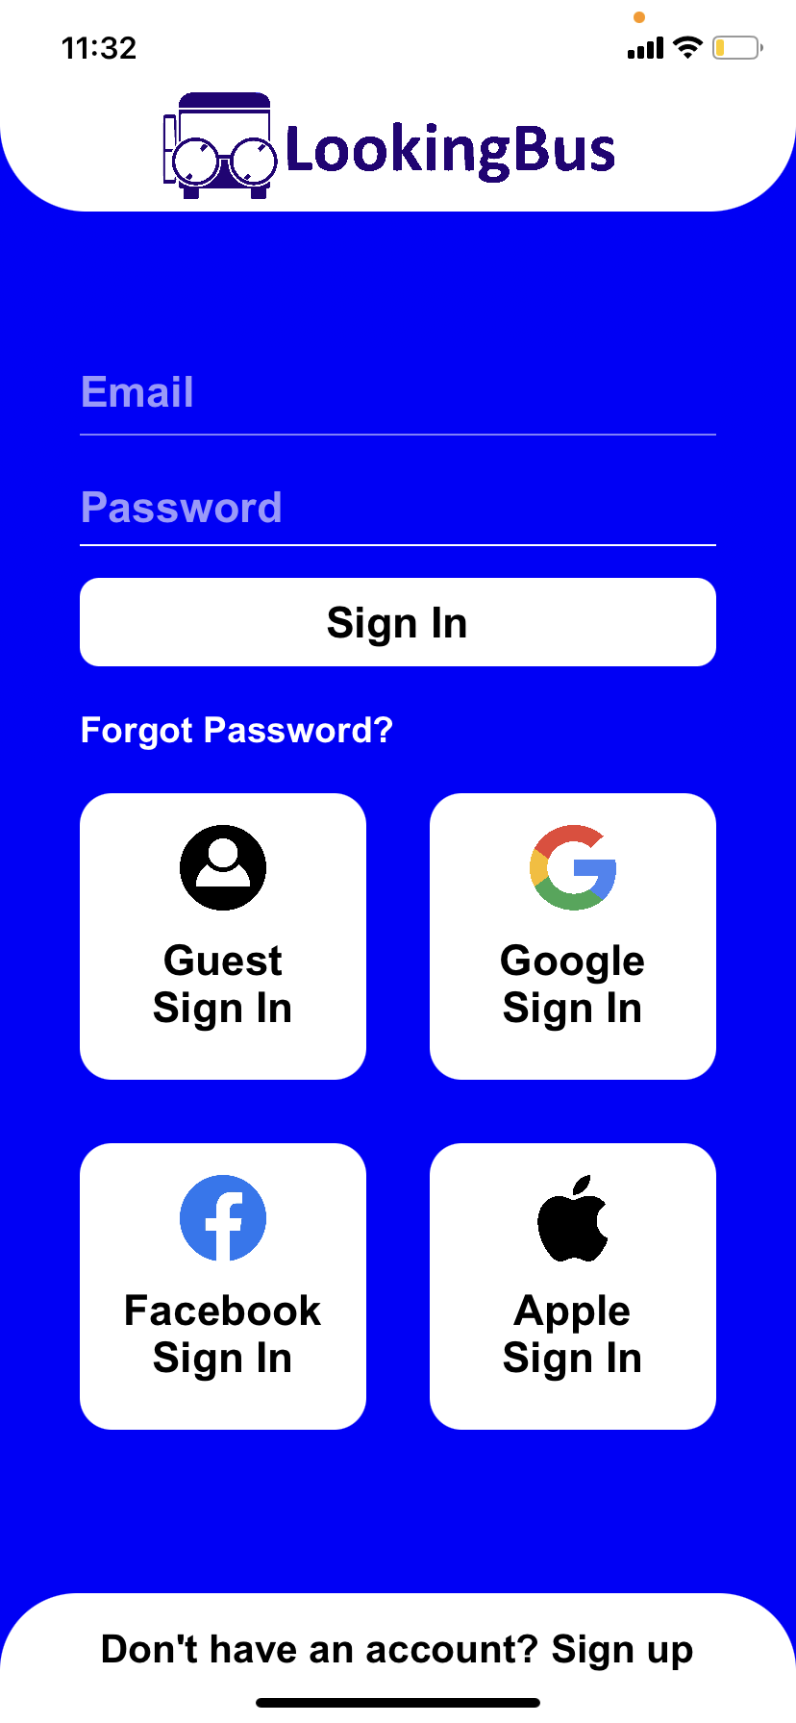
Launch Screen
LookingBus_v0.6.23.8
for Android
LookingBus_v0.7(169)
for iOS

Slide 18
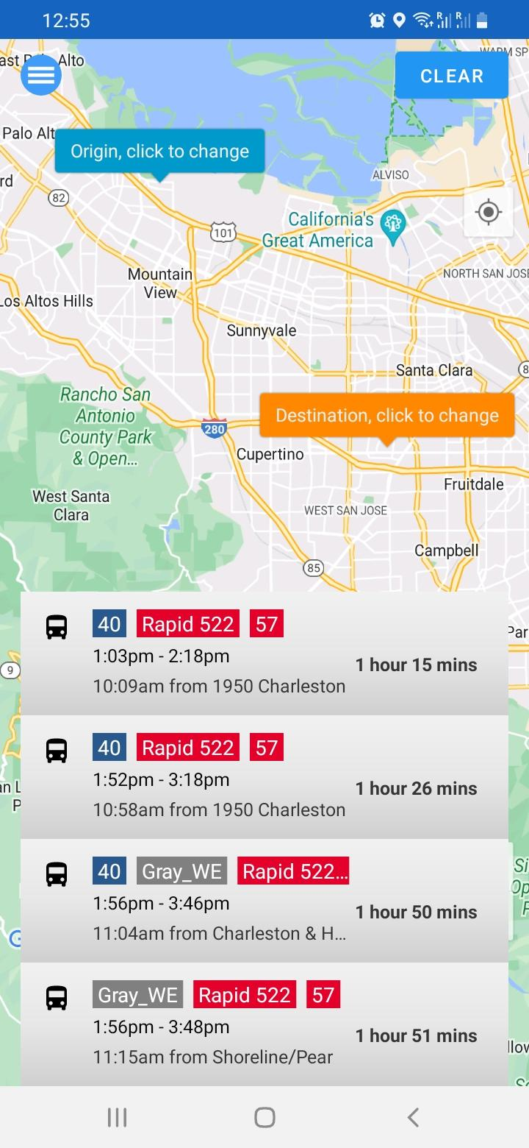
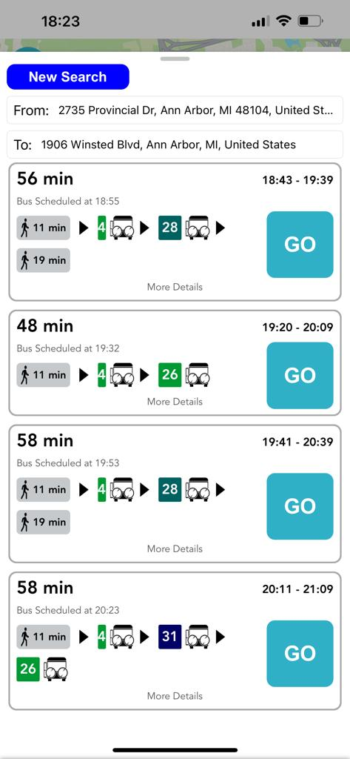
Map & Picking a bus route
LookingBus_v0.6.23.8
for Android
LookingBus_v0.7(169)
for iOS

Slide 19
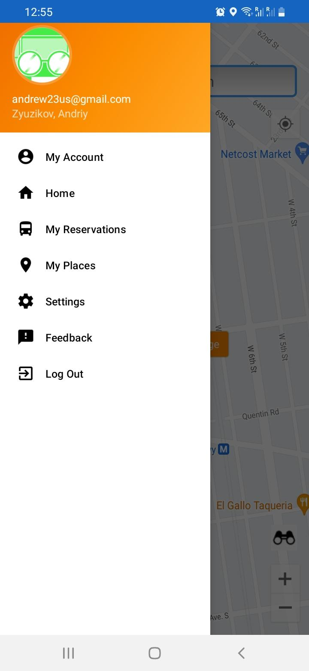
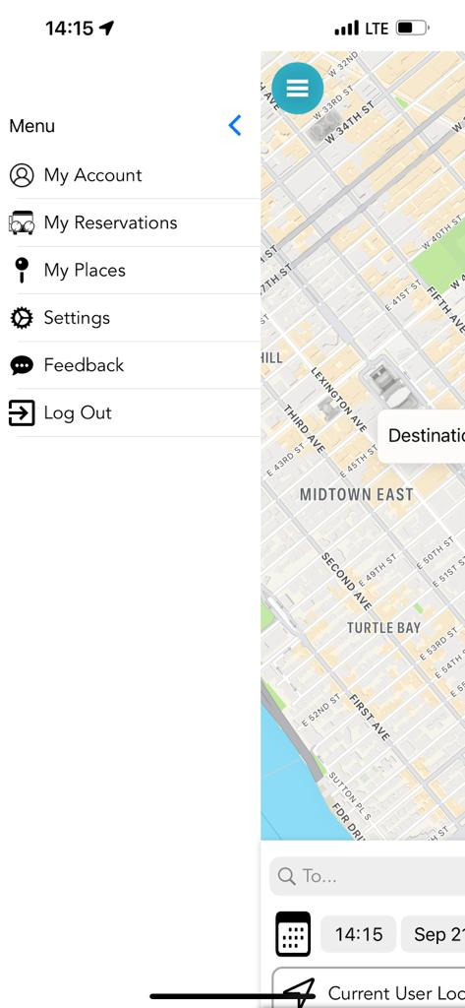
Navigation Drawer
LookingBus_v0.6.23.8
for Android
LookingBus_v0.7(169)
for iOS

Slide 20
Test suites
Test suite 1 Account credentials | Test suite 2 Bus ride as logged in User | Test suite 3 Bus ride as a Guest | Test suite 4 Settings of logged in User | Test suite 5 Settings of a Guest
- create account - restore password - login by email/pass - Google login - Facebook login - log out | - typing address manually - choosing address on map - choosing address from saved ones | - typing address manually - choosing address on map | - change special condition - send feedback - delete reserved bus ride - add "my place" - delete "my place" - settings - text only mode | - change special condition - send feedback - delete reserved bus ride - add "my place" - settings - text only mode

Slide 21
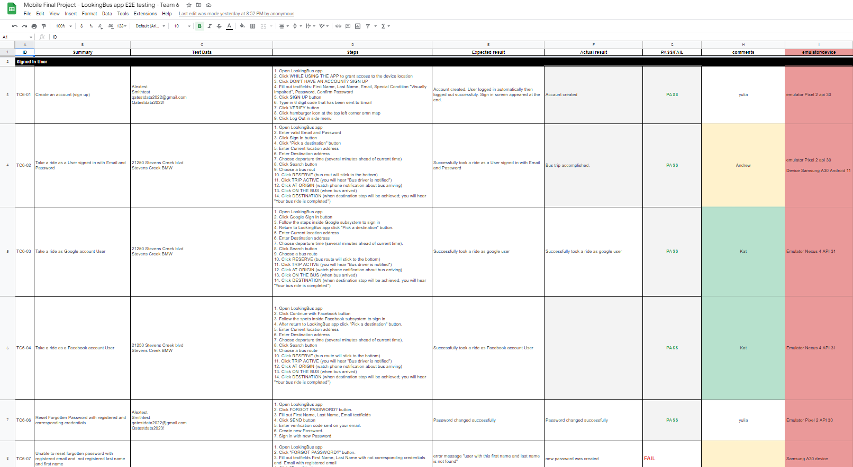
Test Cases (TC)
Link to TC in Google Doc: https://docs.google.com/spreadsheets/d/1kUbS_OlTXcLR-3pKOfbSMRR6KqQm_OHOaG95JTJhrpk/edit#gid=595550031

Slide 22
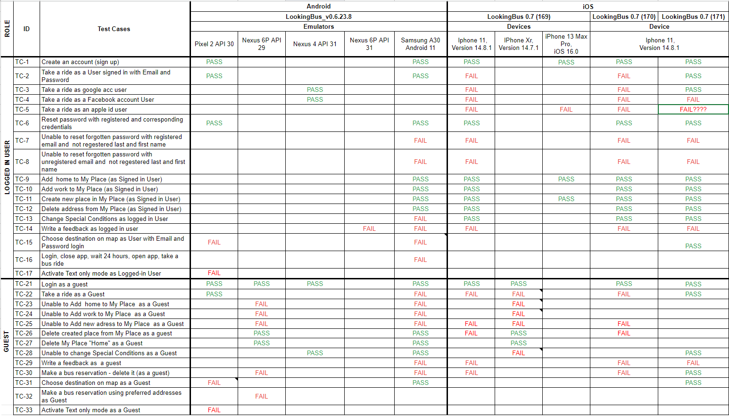
Test Cases Status Matrix

Slide 23
We used Jira as centralised
project management tool
to document TC,
and Test Executions,
Report defects

Slide 24
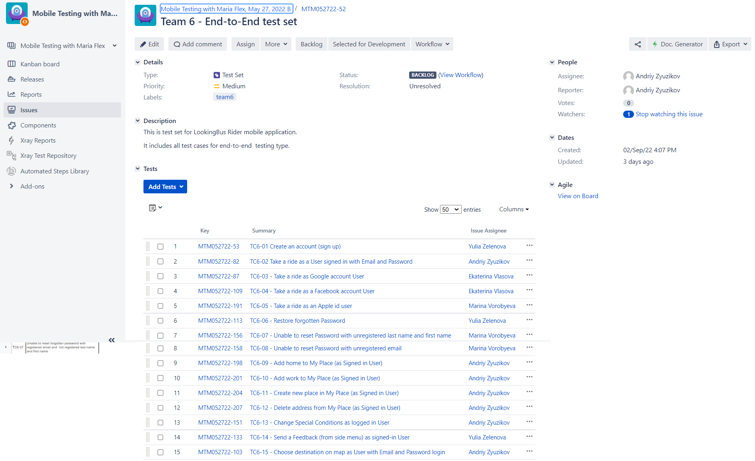
Test Set in Jira
Link to Jira: https://jira.portnov.com/browse/MTM052722-52

Slide 25
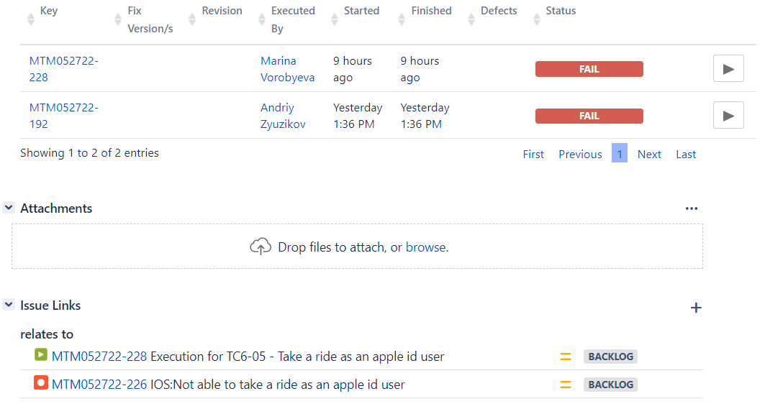
Execution example in Jira

Slide 26
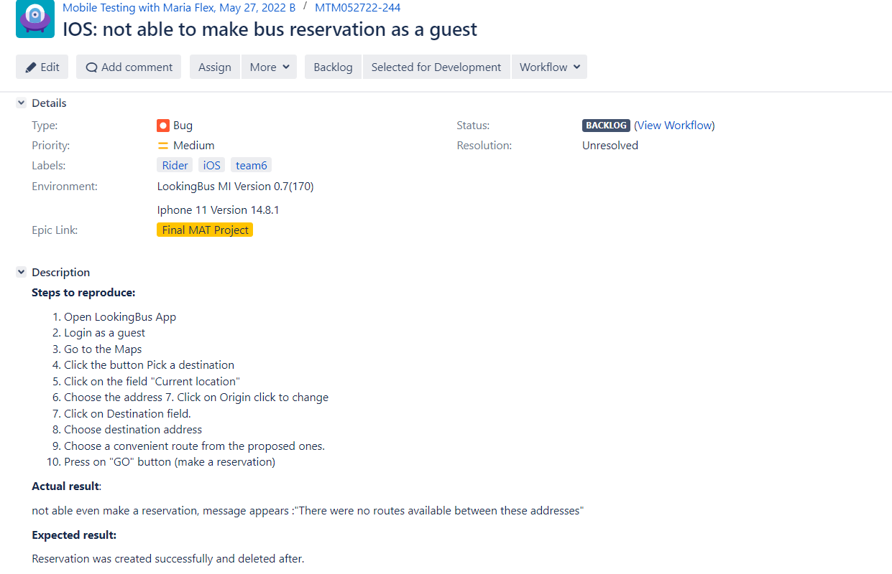
Bug report example in Jira

Slide 27
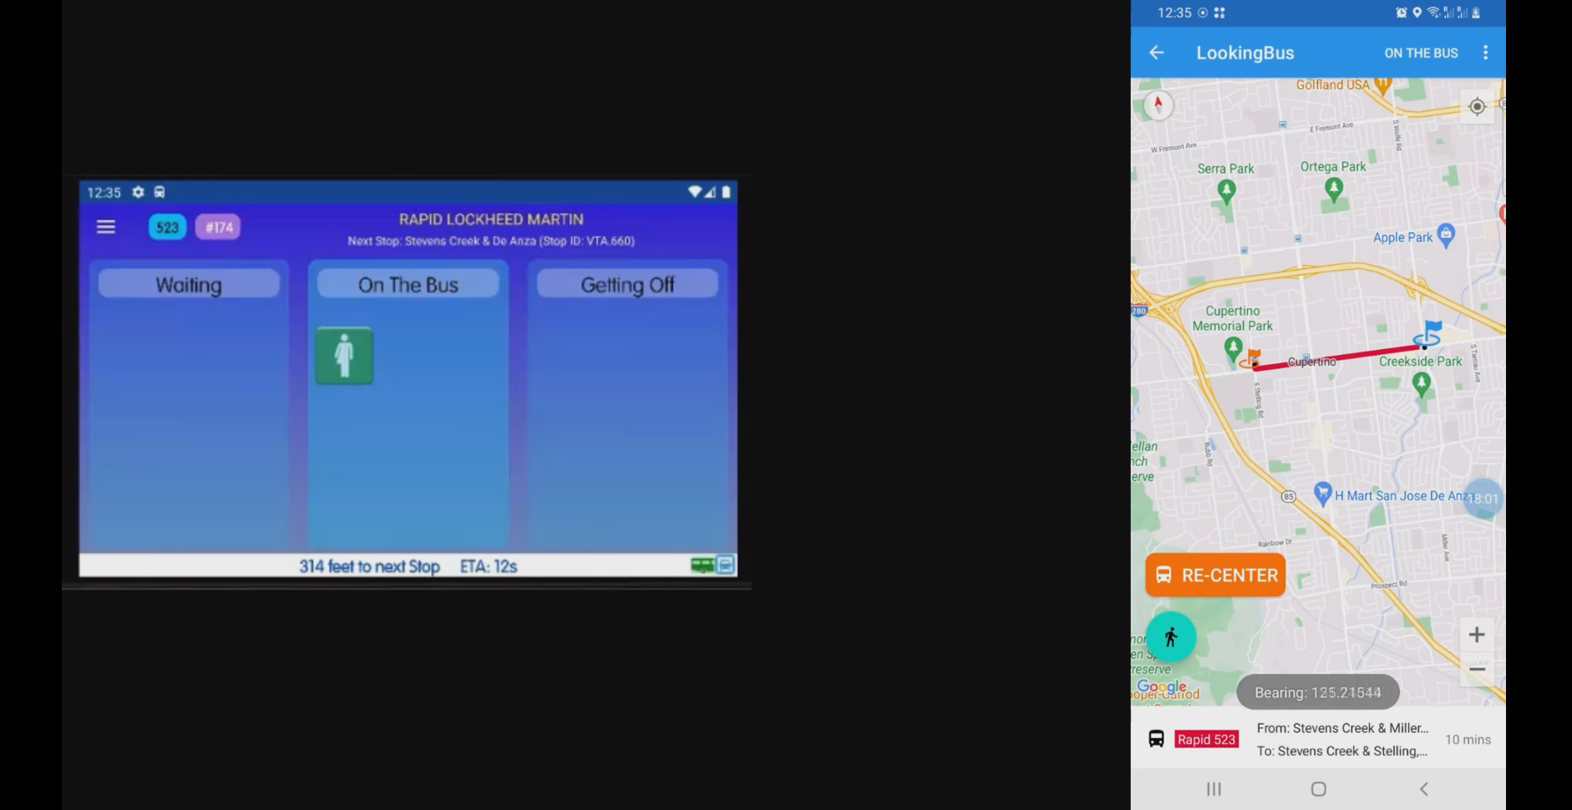
A bus ride TC execution
using Driver and Rider apps
Link to TC and video in Jira: https://jira.portnov.com/browse/MTM052722-52

Slide 28
E2E testing results

Slide 29
Test cases statistics
Total TC: 30
Total executions: 112
Total PASS: 59
Total FAIL: 53

Slide 30
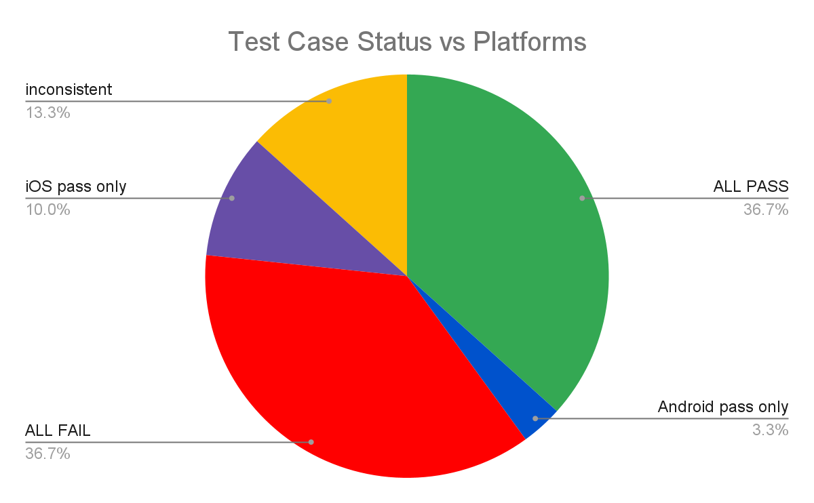
Test cases statistics

Slide 31
Functionality that worked in
all environments with last build
Create Account
Recover Password
Locked Special Condition settings
Add My Place
Take a bus ride as a logged-in, Google, Apple ID User

Slide 32
Test cases failed in
all environments
Security defects while recovering Password,
Sending Feedback
Guest could save Places
Text only mode

Slide 33
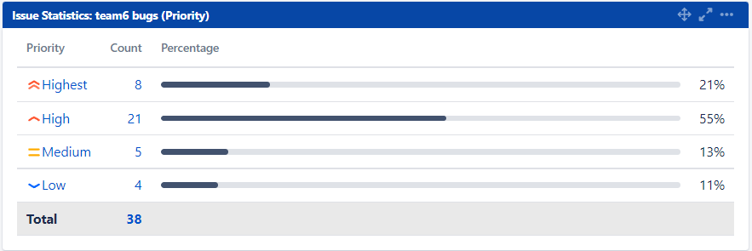
Bug reports statistics

Slide 34
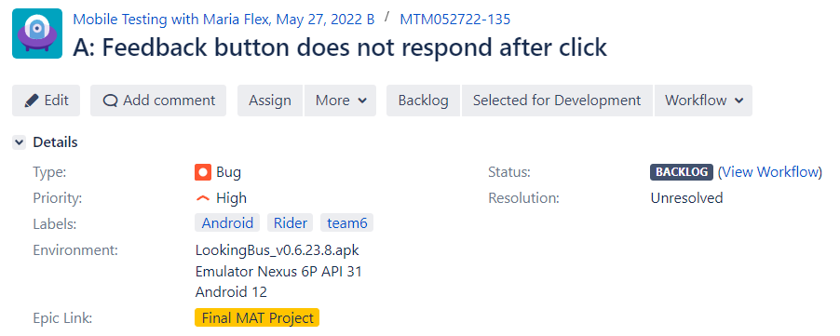
Logged-in User Feedback bug
and logs example
The bug report Jira: https://jira.portnov.com/browse/MTM052722-135

Slide 35
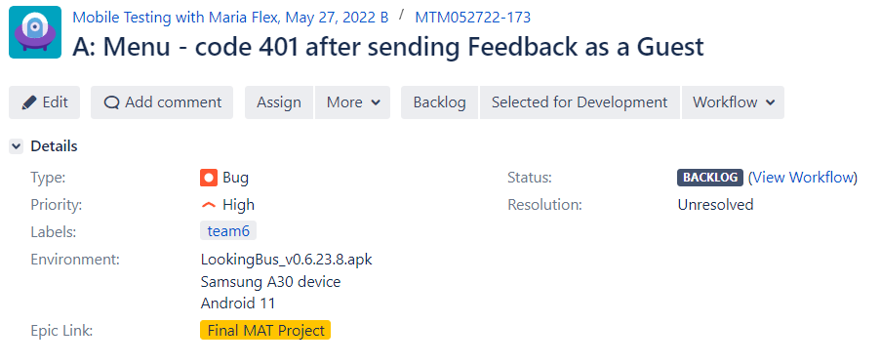
Guest Feedback bug
and logs example
The bug report Jira: https://jira.portnov.com/browse/MTM052722-173

Slide 36
Final thoughts
App is not ready to be released
Often we got “please log in” or “sorry, error occured” message in the middle of TC
Bus rides worked on Android and in last build on iOS (except Facebook)
Feedback option does not provide status message after sending
Special Condition settings did not save “Visual impaired” and “Wheel Chair” options (only “None” and “Blind”)
Choosing destination on map sometimes led to ANR on Android
Text mode activation crashes the app

Slide 37
References
Mobile Vendor Market Share United States Of America
Mobile Operating System Market Share United States Of America
Mobile iOS Version Market Share United States Of America
Mobile Android Version Market Share United States Of America
Smartphone Use and Activities by People with Disabilities
Team6 test plan
Team6 test set in Jira
Team6 test cases in Google Sheet

